Slide 1


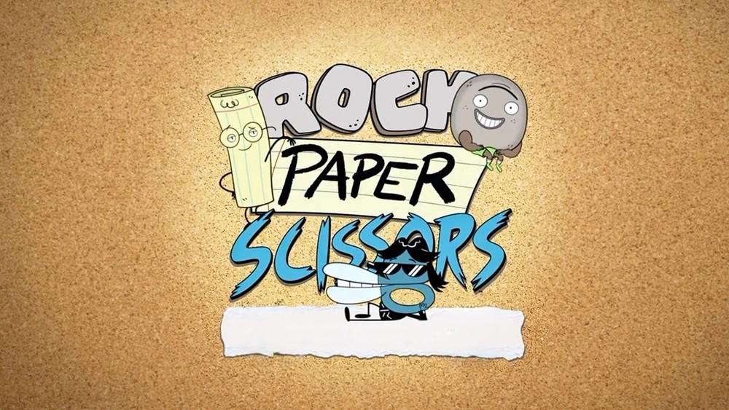
rock paper scissor game…
CREATED BY AD1

Slide 2

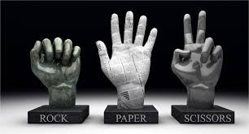
What is the Rock, Papers, Scissors?
It is a two-player game where both simultaneously choose their move out of available moves i.e. rock, paper, and scissors. Based on their moves and rules, the winner is decided. The rules are that Rock beats scissors but loses to paper, Paper beats rock but loses to scissors, and Scissors beats paper but loses to rock

Slide 3


Major steps to code the game:
We need to accept a move from the player i.e. rock paper or scissors.
We are also going to need the computer to select a move at random rock paper or scissors to play against the player
Then, once we have those moves, we are going to compare them and print out the winner.

Slide 4
Algorithm:
We start with randomized computer input by
first, create an array of strings and we store the moves i.e. rock paper scissors in that. So the length of the array = 3.
the computer move would be the randomized element of that list and for that, we use the Random() function on the indices of the array so that we get the randomized index between [0,2].
user move
We take input of the move chosen by the player.
Comparing their moves:
First, we check if there's a tie between them using the equals() function.
Now we check all other possible combinations of rock, paper, and scissors using the if else condition and decide who is the winner.

Slide 5
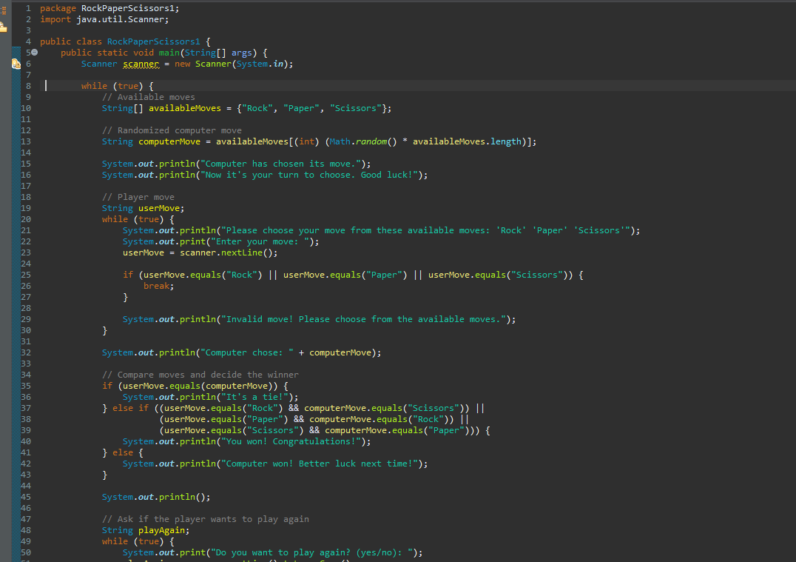
Rock Paper Scissors code in Java :

Slide 6
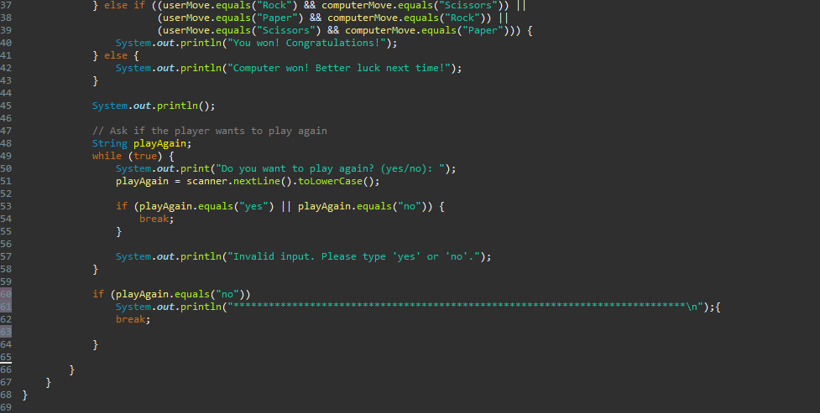

Slide 7
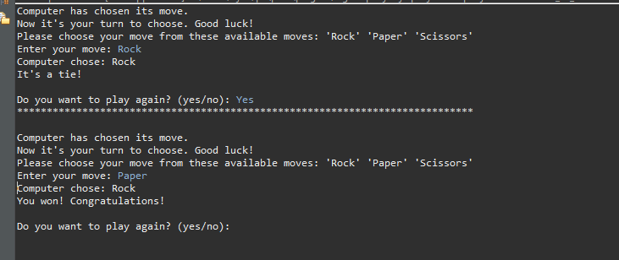

Out put :

Slide 8
Object-Oriented Programming (OOP) Concepts Used
Class Declaration:
java
public class RockPaperScissors1 {
This declares a class named RockPaperScissors1.
In Java, classes are templates or blueprints for creating objects.
Main Method:
java
public static void main(String[] args)
This is the entry point of the program
(main method). It's static because it belongs to the class itself and not to any specific instance of the class.

Slide 9
Encapsulation:
Variables like availableMoves, computerMove, userMove,
and playAgain are encapsulated within the main
method. Encapsulation helps in bundling the data
(variables) and methods (logic) that operate on
the data together as a single unit.
Input Handling:
The Scanner class is used to handle user input (scanner.nextLine()). This is a
common practice in Java for reading input from the console.
Conditional Statements (Control Flow):
while loops are used for indefinite repetition until a certain condition
(break statement) is met. This helps in implementing the game's flow and
handling user interactions (while (true) loops).

Slide 10
System.out.println() statements are used to output messages to the console, providing feedback to the user during the game.
System.out.println() statements are used to output messages to the console, providing feedback to the user during the game.
System.out.println() statements are used to output messages to the console, providing feedback to the user during the game.
Array Usage:
String[] availableMoves = {"Rock", "Paper", "Scissors"}: Arrays are used to
store and accessa collection of items (in this case, the available moves).
String Comparison:
if-else statements are used to compare strings (userMove.equals("Rock"),
playAgain.equals("yes")). String comparison is a fundamental operation in Java
and is used here to determine game outcomes and user choices.
Output Printing:
System.out.println() statements are used to output messages to the console,
providing feedback to the user during the game.

Slide 11
Conclusion:
The Java Rock-Paper-Scissors game demonstrates fundamental programming concepts such as conditional statements, loops, input handling, and output display. It provides an interactive experience where the user can play against the computer, making choices and receiving immediate feedback on the outcome. The game's structure allows for easy understanding and modification, making it suitable for beginners learning Java programming.

Slide 12
THANK YOU !...
DONE BY;
RAJESH.
SANJAY.
VASIKARAN.
HARIS MURUGAN.

